Slide 1
NYC GREEN TAXI 2015
Team 5

Slide 2
Conceptual Model

Slide 3
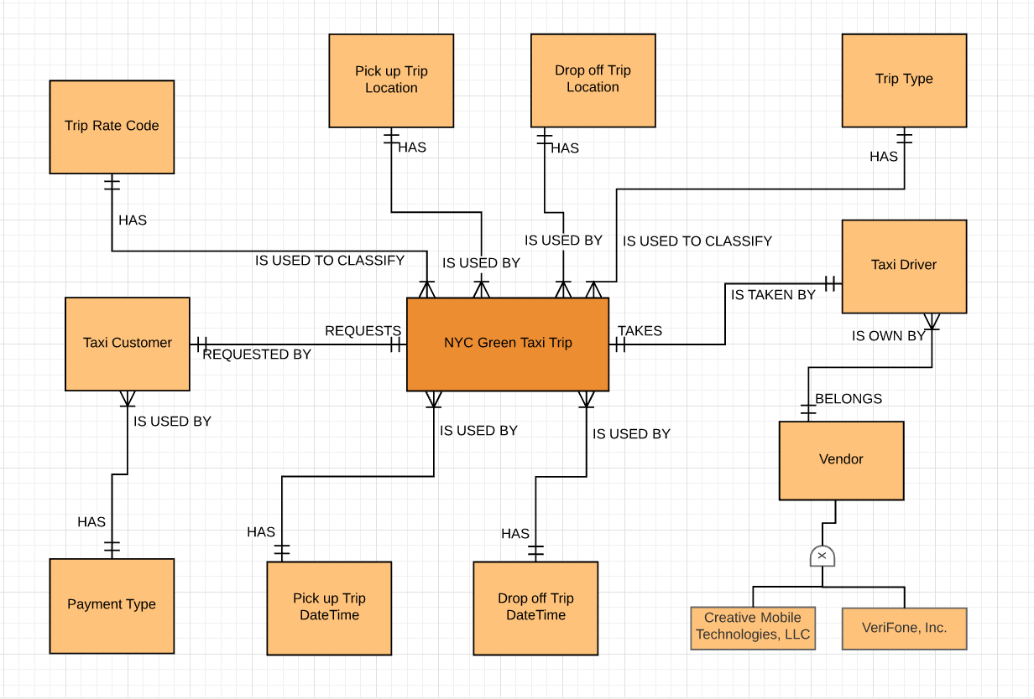

Slide 4
Data Quality Scorecard

Slide 5
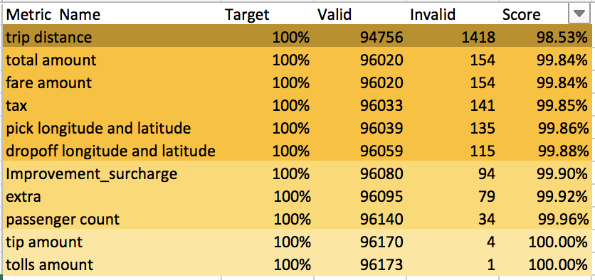
Good Quality

Slide 6
Dimensional model
Grain Statement

Slide 7
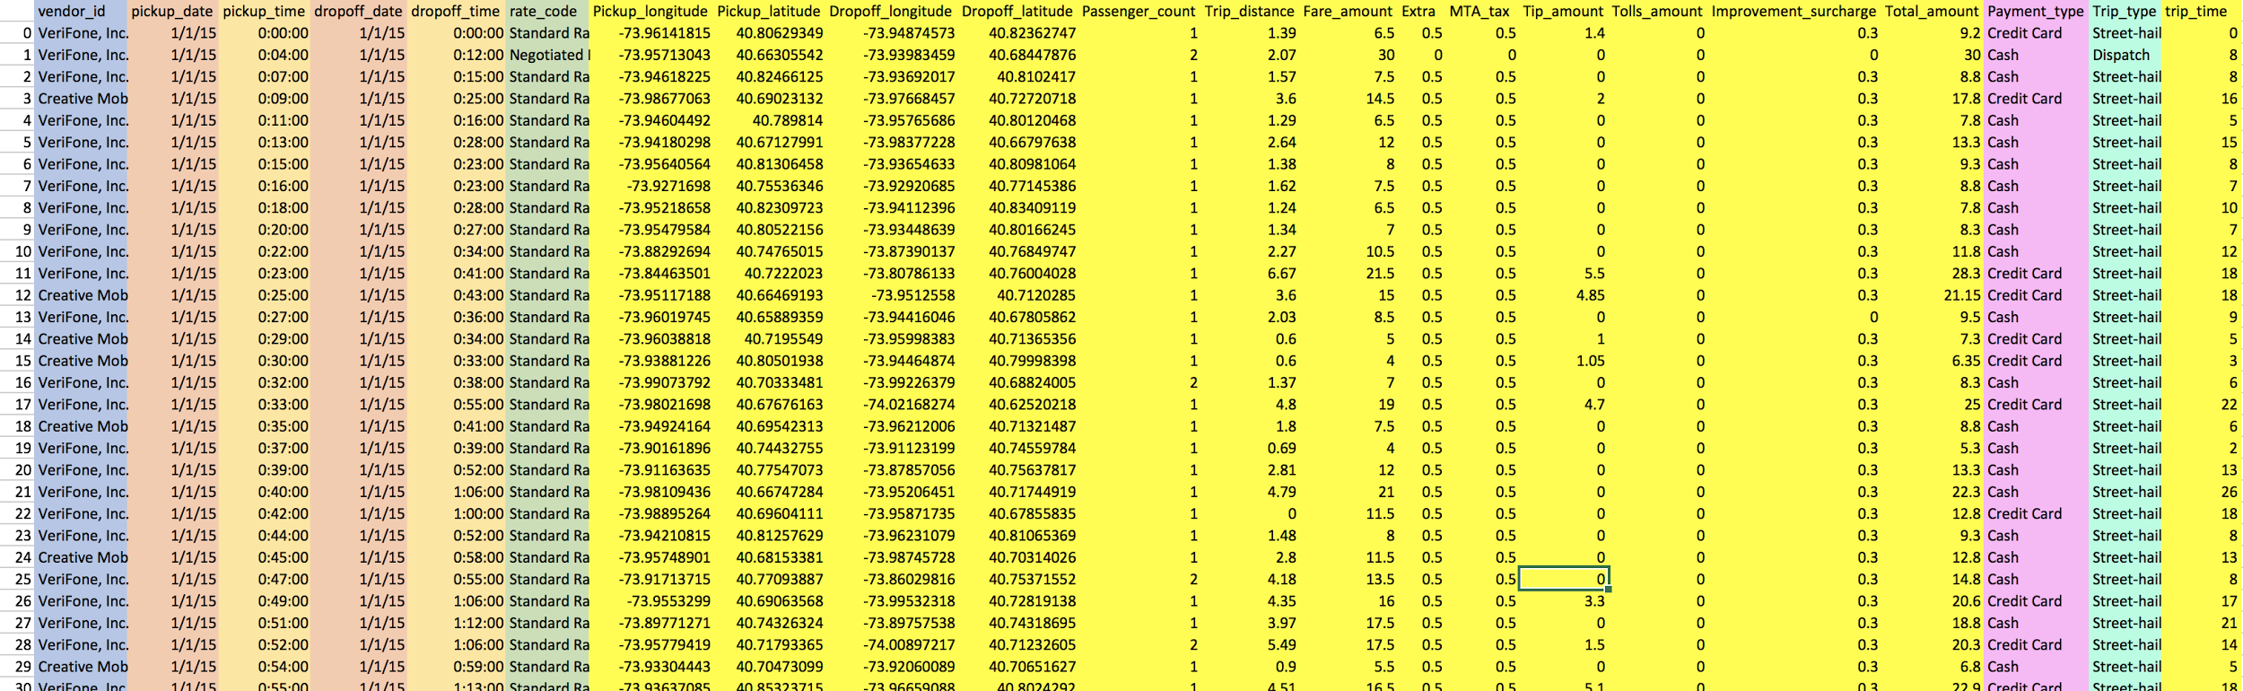
Dimensional Model

Slide 8
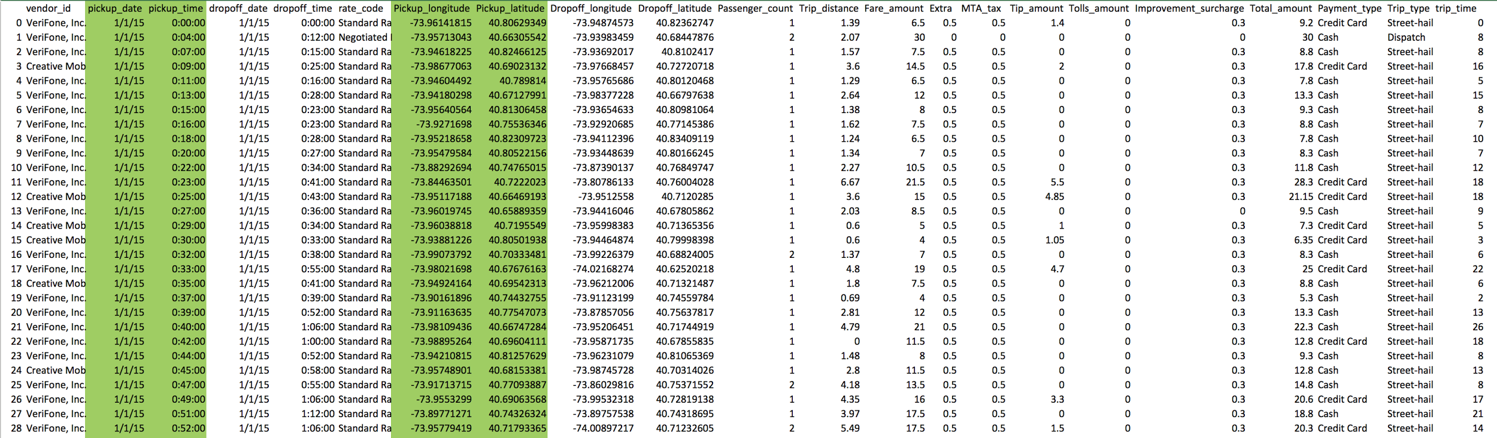
Declare the Grain

Slide 9
Data Dictionary

Slide 10
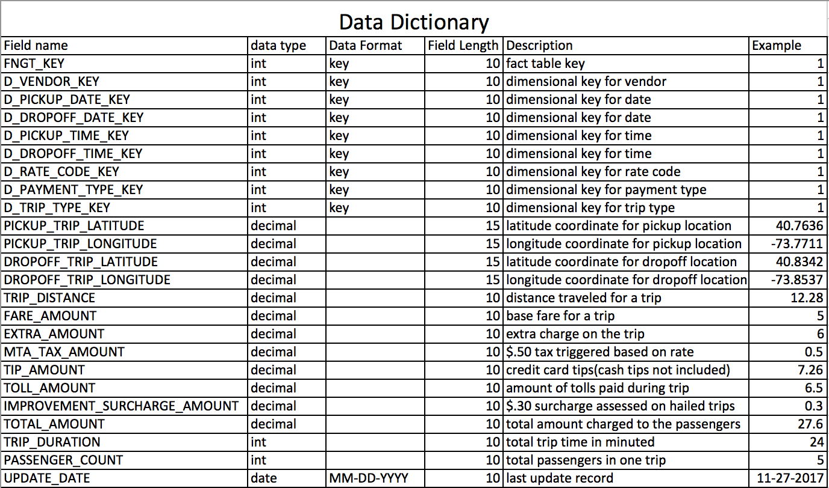

Slide 11
Data Visualizations

Slide 12
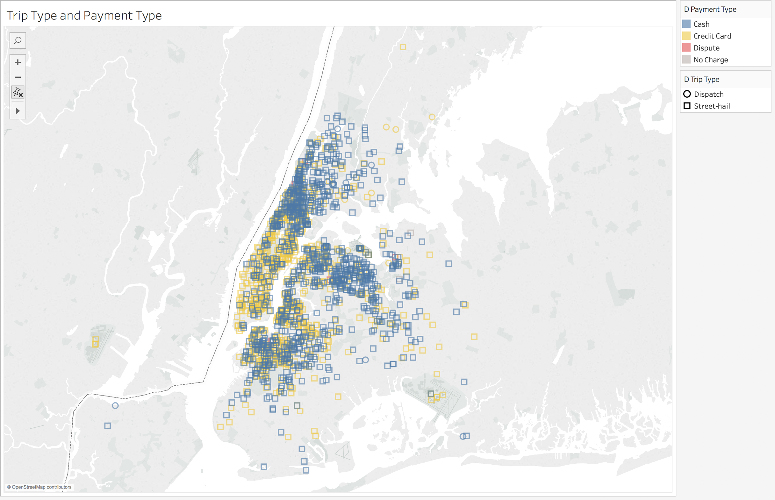
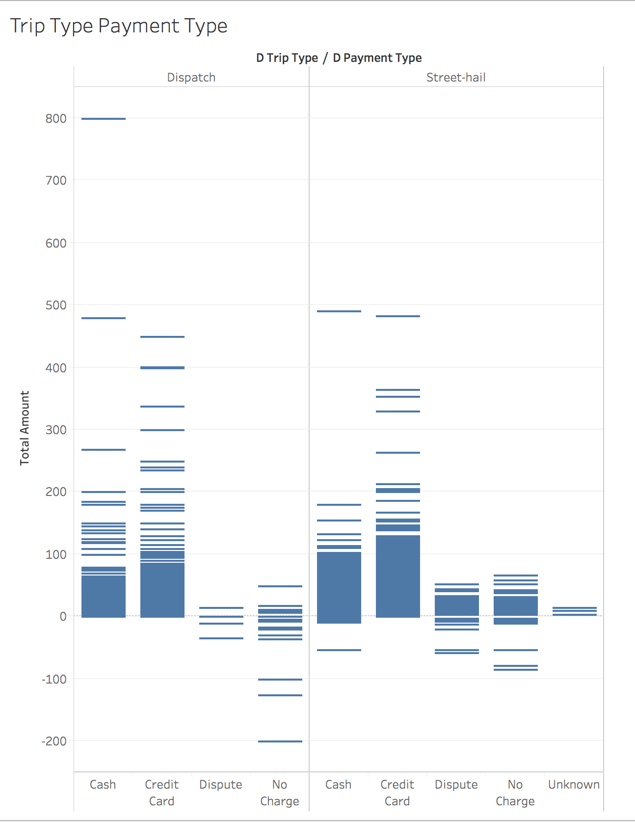
Mapping Trip Type & Payment Type

Slide 13
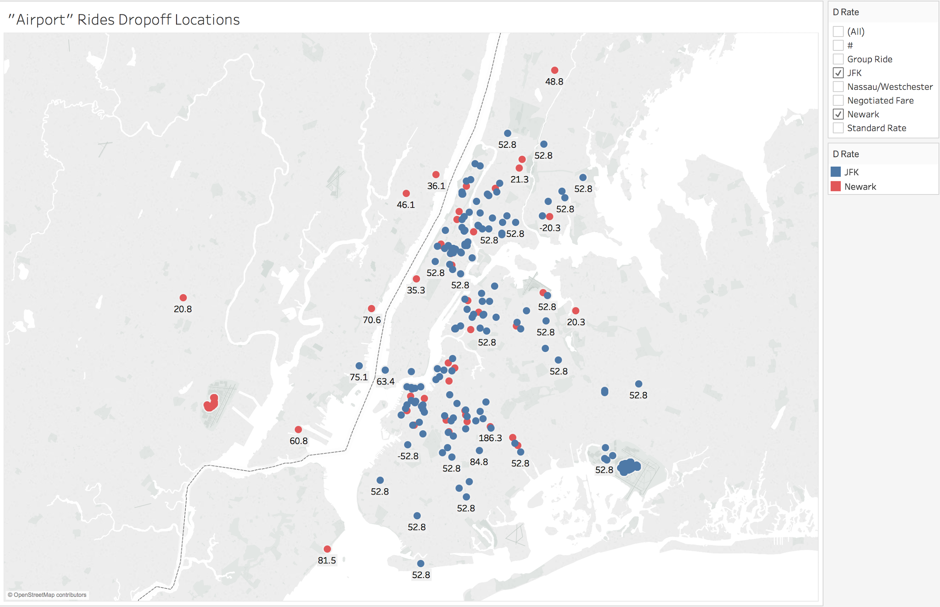
Mapping-Rate Code(airport)

Slide 14
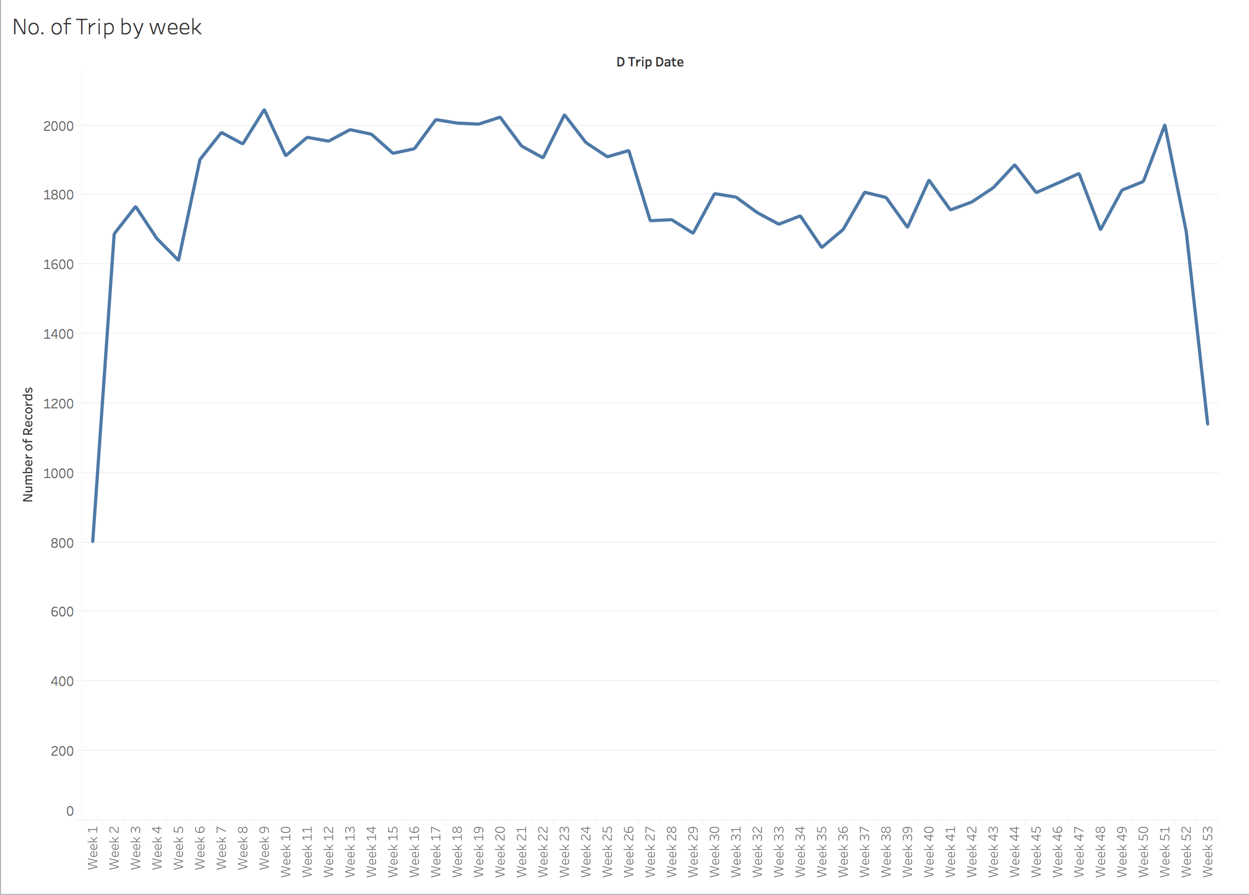
No. of Trip by Week

Slide 15
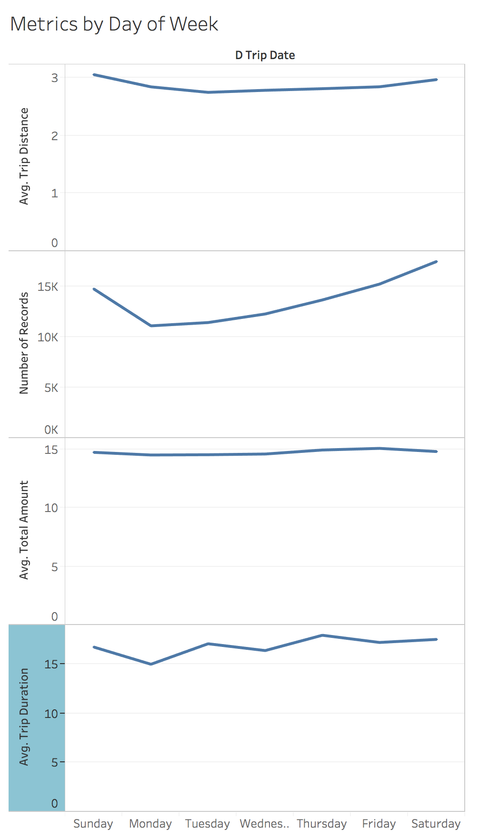
Metrics by Day of Week

Slide 16
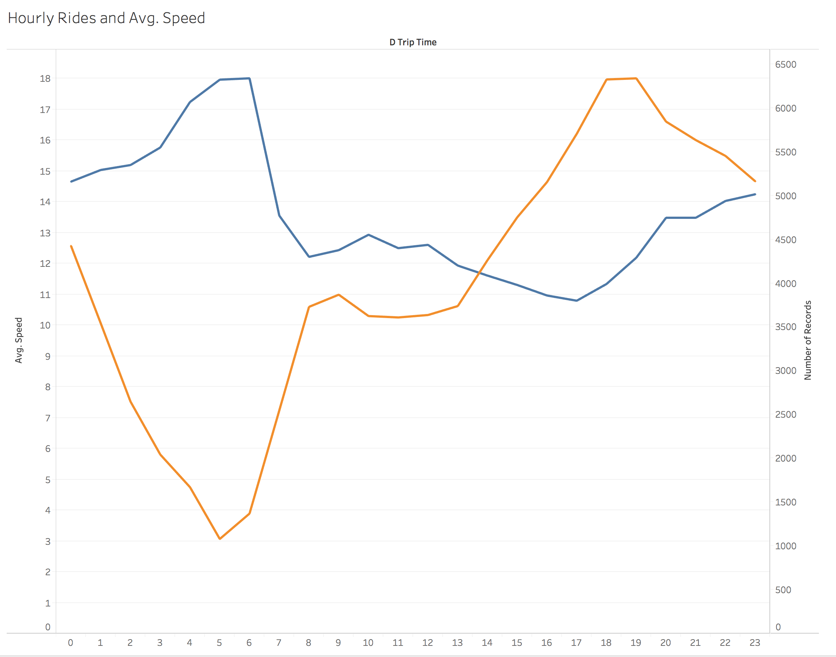
Rides and Speed

Slide 17
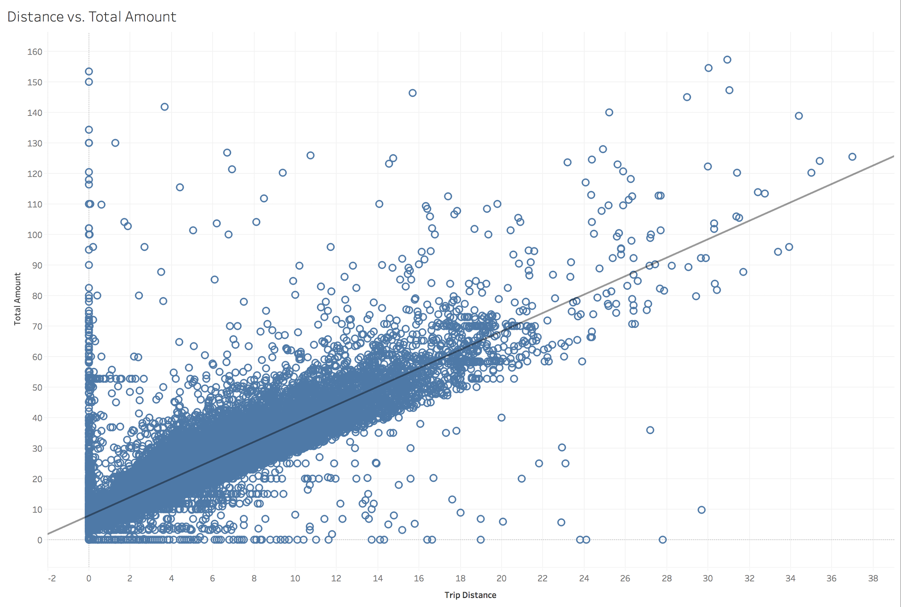
Trip Distance and Total Amount

Slide 18
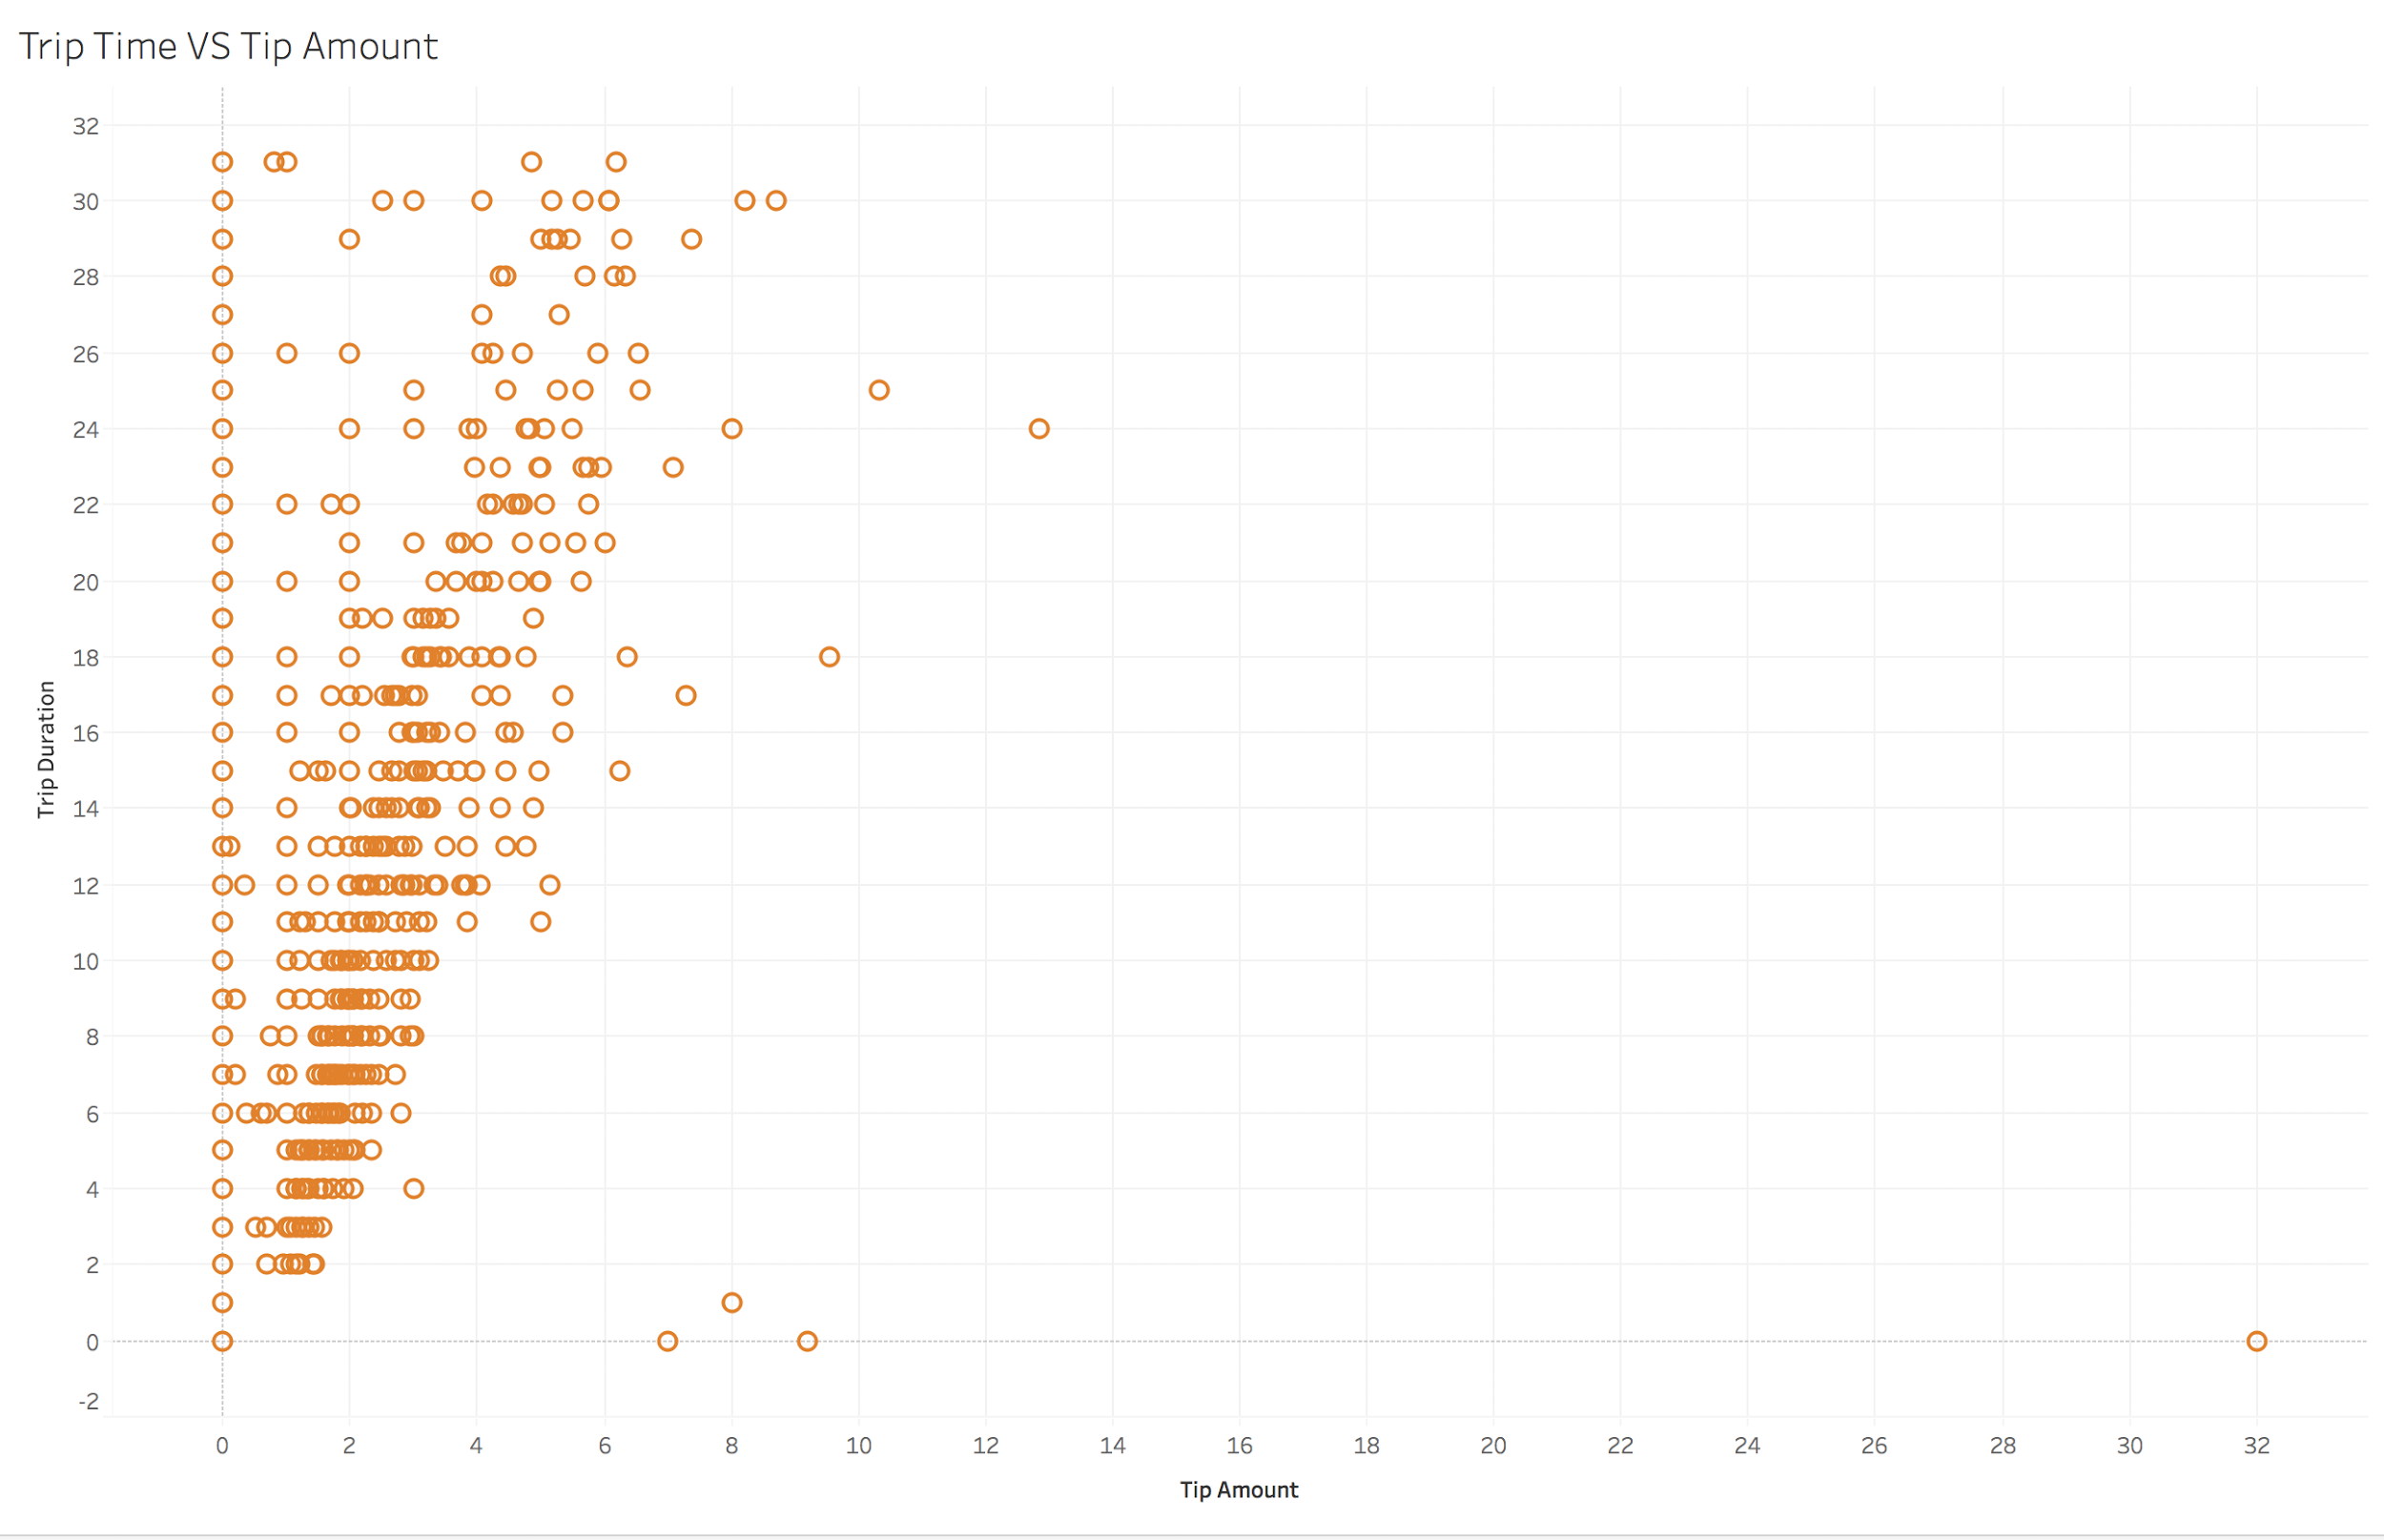
Trip time and tip amount-Week 2

Slide 19
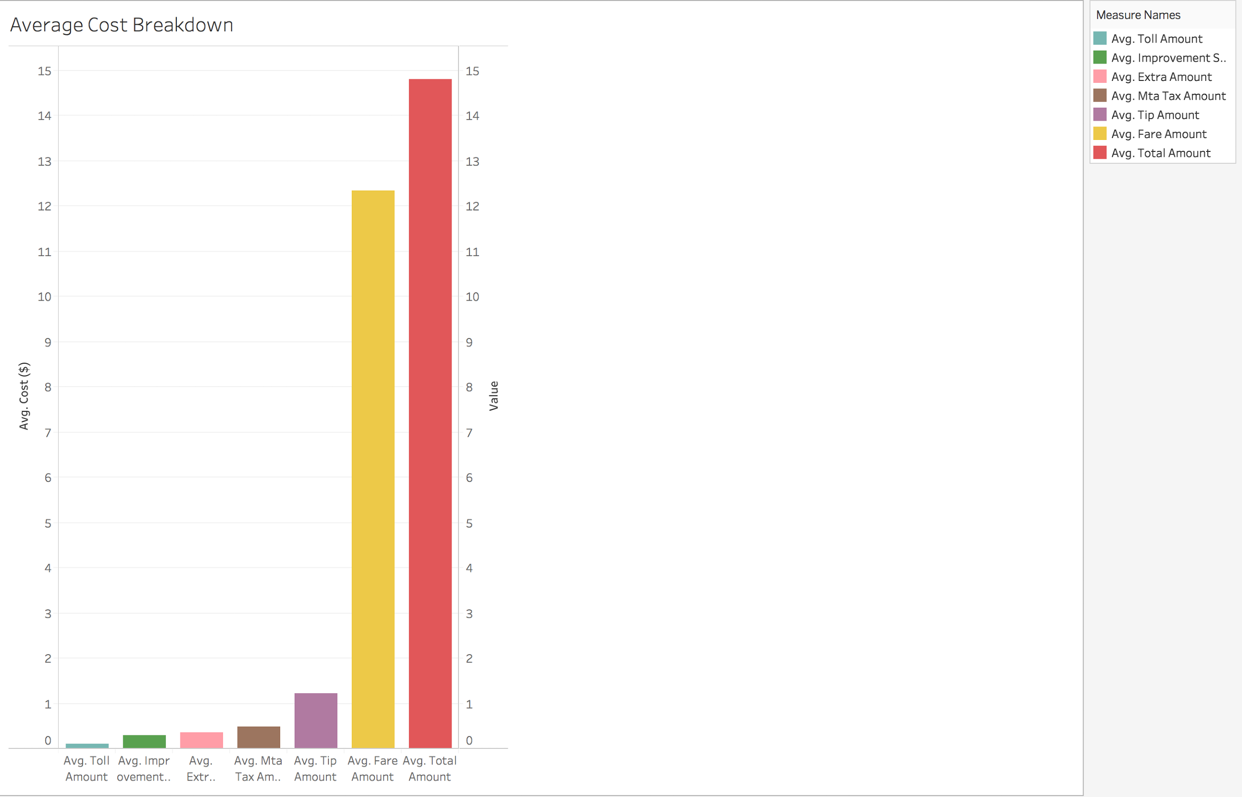
Cost Breakdown

Slide 20
Thank You

